Slide 1
PROFILE
DEPARTMENT
OF
ZOOLOGY
JHARKHAND COLLEGE, DUMRI.
HEAD OF THE DEPARTMENT:- Dr. Amita Mishra.
Assistant professor.

Slide 2
INDEX
SL.no Content
1 Image of the Department.
2 Teachers profile.
3 Introduction of the subject.
4 vision of the Department.
5 Mission of the Department.
6 Goal of the Department.
7 Teaching Methodology

Slide 3
SL.no content
8 Courses offered.
9 Performance of the students.
10. S.W.O.C

Slide 4
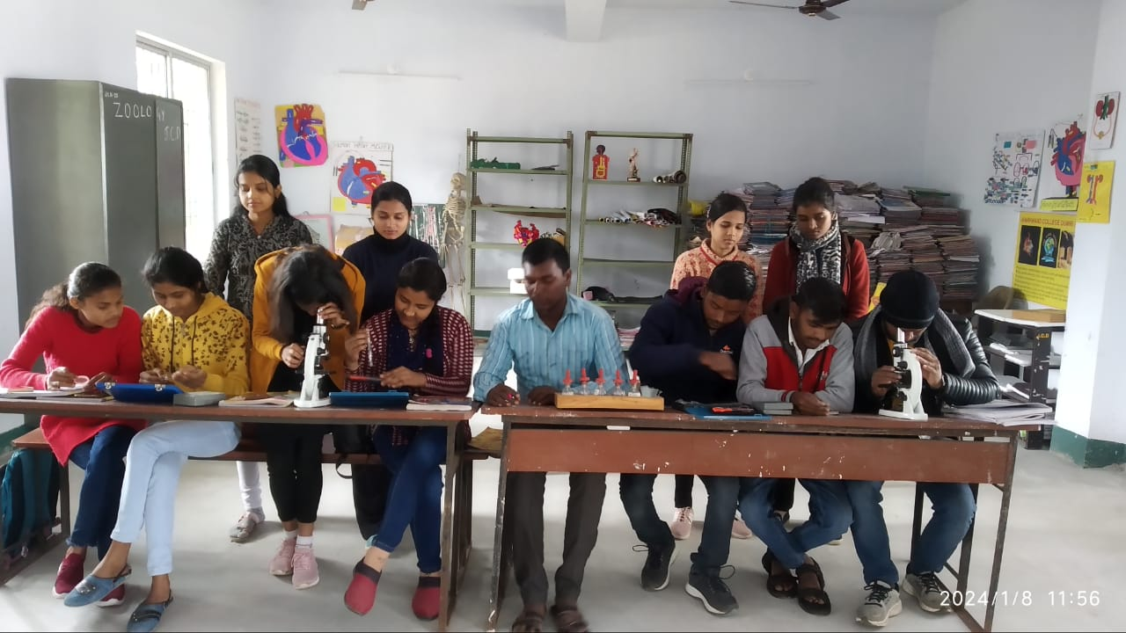
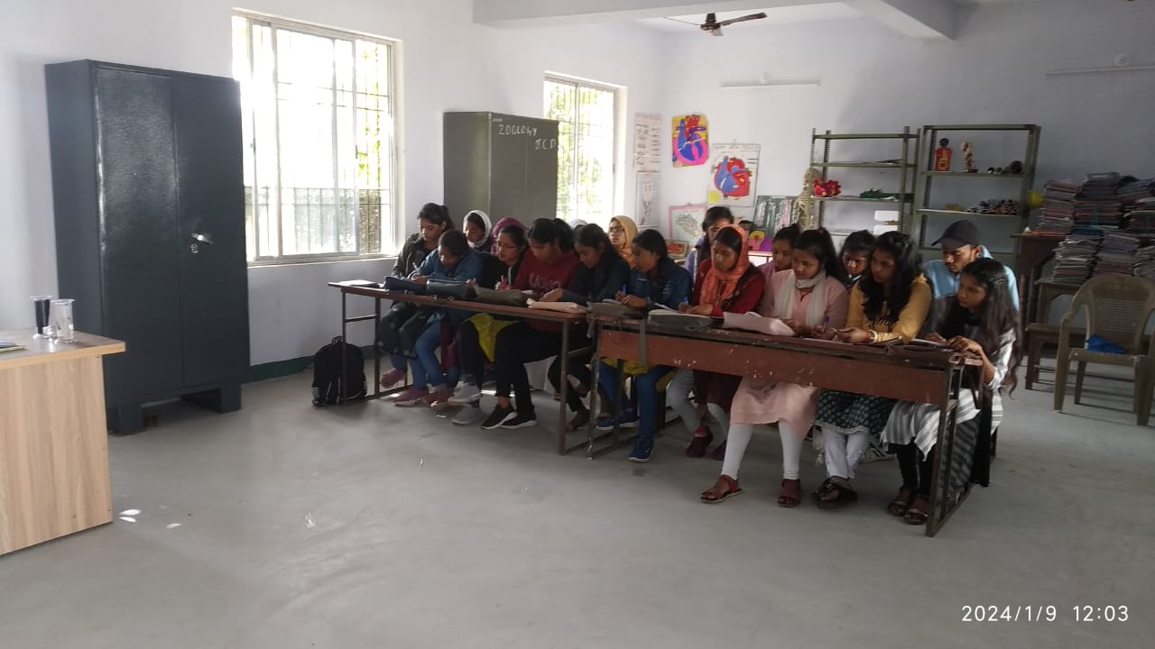
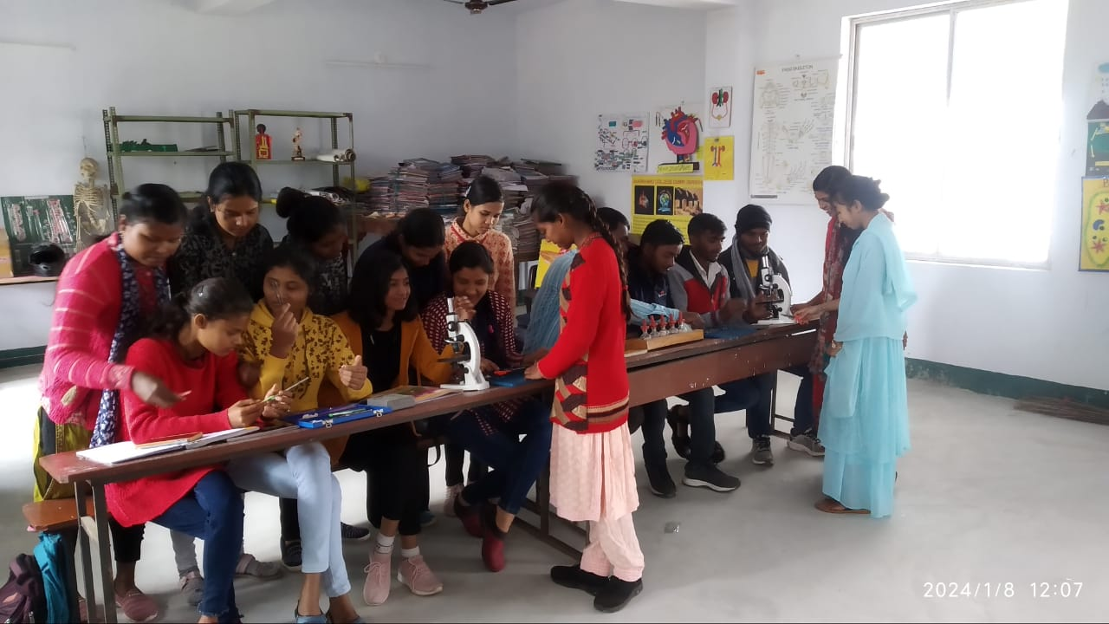
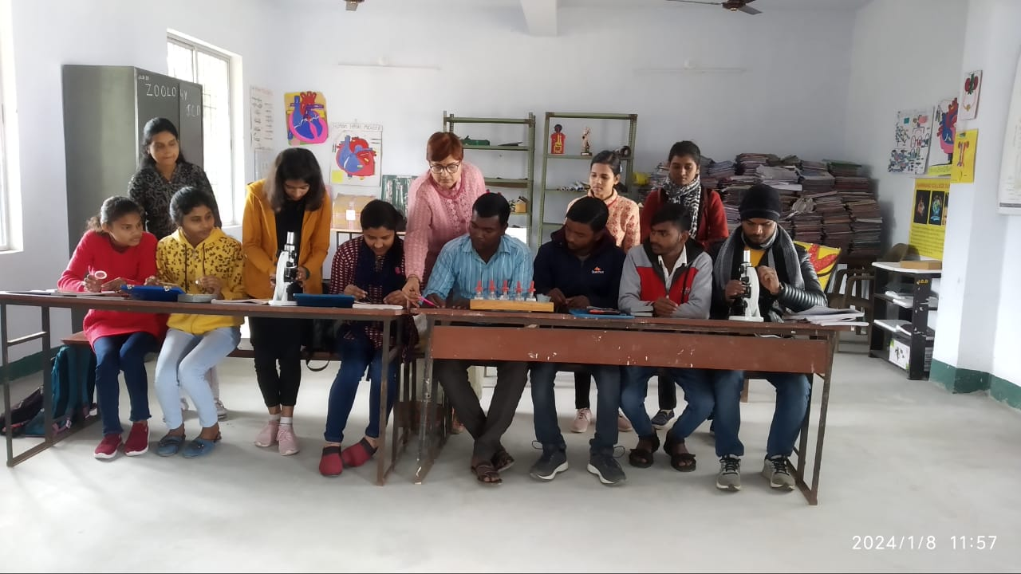

Slide 5
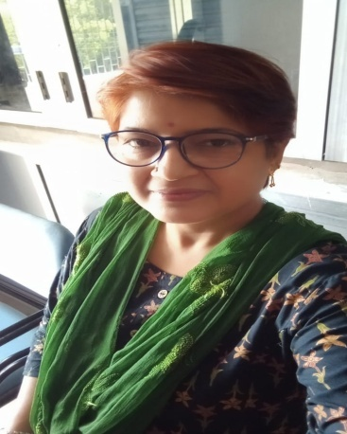
2. TEACHERS’ PROFILE
Name of the Teacher:- Dr. Amita Mishra
Designation:- Assistant Professor
Head of the Department
Department of Zoology.
3.DOB:- 14.02.1982
4.Date of Joining:- 20.04.2010
5.Address:- Guru Nanak College Road
Dhanbad. 826001
6.E.mail Id:- drameetamishra@gmail.com
7. Mobile no:- 9534229602

Slide 6
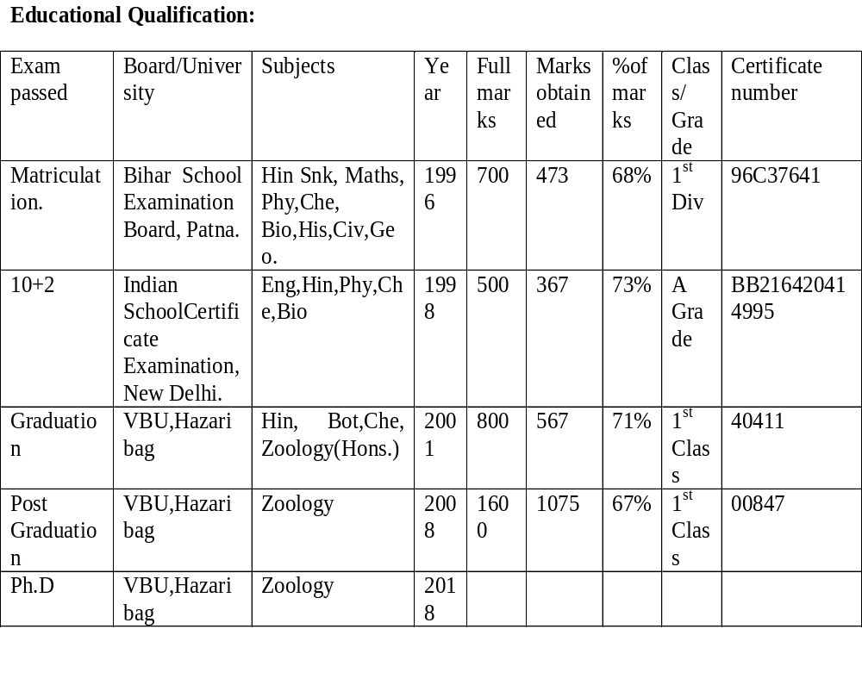

Slide 7
Topic (Ph.D) : Topic of research :- Studies on Physico-Chemical Parameters of some fresh water bodies of Dhanbad & its impact on aquatic insects habitat selection & feeding.
Date of notification :- 03.02.2018

Slide 8
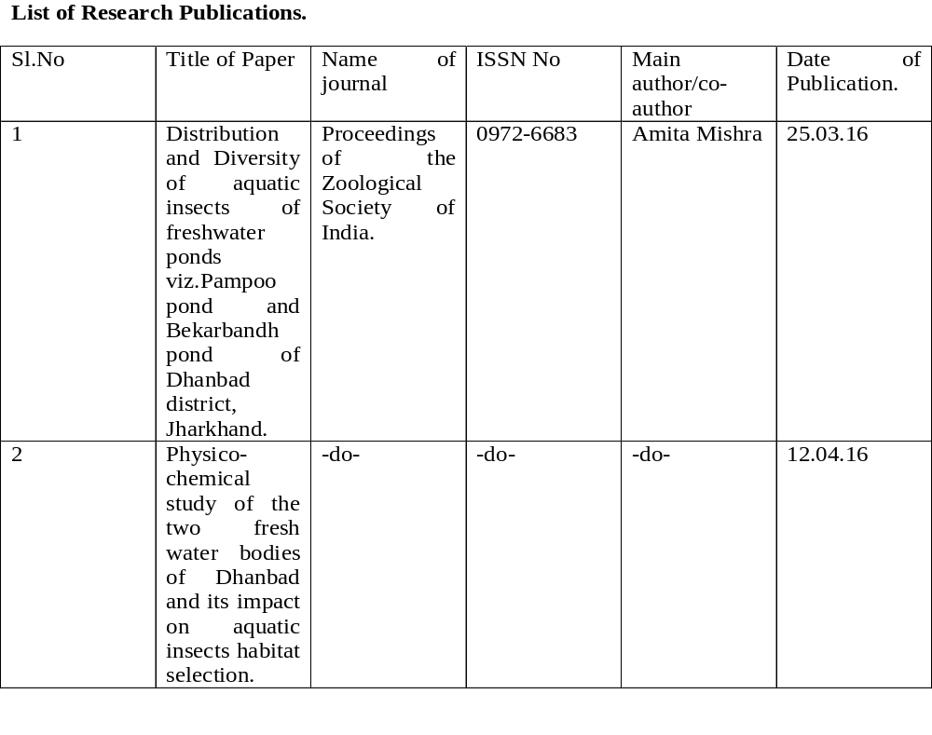

Slide 9
3. | Aquatic insect biodiversity and water quality parameters of the Bekarbandh pond of Dhanbad district. (Jharkhand) | -do- | -do- | -do- | 12.03.18

Slide 10
4. | Impact of Physico-chemical factors of the soil on the population dynamics of Beetles of the Dhanbad District (Jharkhand). | -do- | -do- | -do- | 15.10.19

Slide 11
5. | Study of Zooplanktons of the Maithan dam of the Dhanbad district, Jharkhand. | -do- | -do- | -do- | 20.10.19

Slide 12
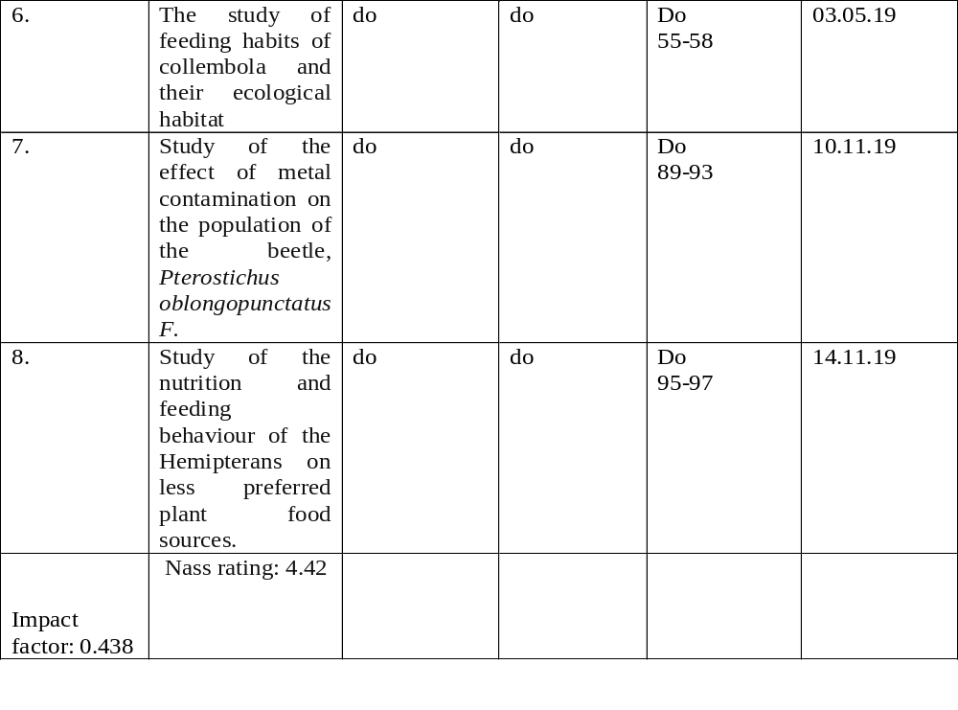

Slide 13
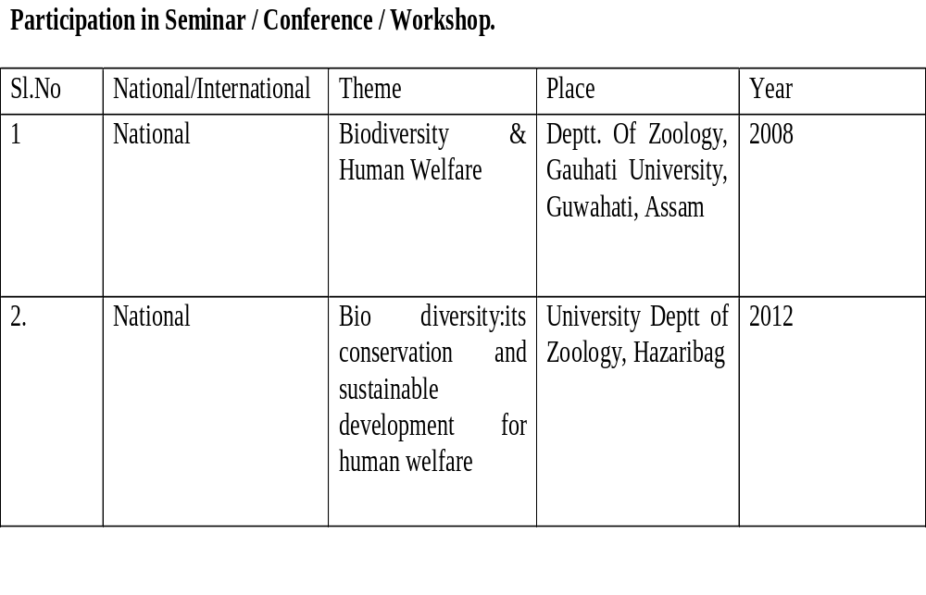

Slide 14
3. | International | Recent trends in life science researches vis-à-vis natural resource management, sustainable development and human welfare. | Vinoba Bhave University, Hazaribag. | 2009

Slide 15
4. | Induction training/Orientation programme |  | Indian Institute of Technology( Indian School of Mines), Dhanbad. | 2019
5. | National Conference | Renewable energy harvesting with latest technological development | PTPS College, Patratu, Ramgarh (Jharkhand) | 2020

Slide 16
Webinar and Faculty Development Programme.
Participated in UGC Sponsored webinar on the topic:- “NEP-2020 Implementation Plan: Multiple Entry and Exit System” on dated 09.10.2023.
Participated in UGC Sponsored webinar on the topic:- “NEP-2020 Implementation Plan: Changing role of teachers” on dated 10.10.2023.

Slide 17
Participated in UGC Sponsored webinar on the topic:- “NEP-2020 Implementation Plan: Technology Use and Integration” on dated 11.10.2023.
Participated in NEP 2020 Orientation & Sensitization Programme, under Malaviya Mission Teacher Training Programme (MM-TTP) of UGC organized by IIT ISM, Dhanbad , from dated 04.12.23 to 15.12.23

Slide 18
BOOK EDITED
ECOLOGY OF AQUATIC INSECTS
ISBN :- 978-81-906091-9-7.
NARENDRA PUBLISHING HOUSE
PUBLISHER AND DISTRIBUTOR:-
1417, KISHAN DUTT STREET, MALIWARA, DELHI- 110006. INDIA

Slide 19
3.An Introduction of subject:- Zoology
Zoology is the study of life in its entity.
Initially it was the description of life forms.
Identification, nomenclature and classification of all living forms is been done by scientists.

Slide 20
In later years, the focus of the scientists shifted on Anatomy and Physiology of living beings.
In the 19th and 20th century, Physics and Chemistry were applied to Zoology and the new branch of Biotechnology became the prominent face of Zoology.

Slide 21
4. VISION OF THE DEPARTMENT
Since the establishment of the college, in 1985, the Department of Zoology is spreading the themes like environmental issues, adolescent problems, reproductive health, parasitic diseases, Apiculture, Sericulture, Lac-culture, Fisheries etc.

Slide 22
The Department of Zoology , still needs to emphasize the general awareness in the society about Bio-diversity, their conservation, sustainable development and other global issues.
The Department of Zoology is a nurturing ground for an individual’s holistic development and to inculcate Fraternal spirit for effective contribution to the society.

Slide 23
5.Mission of the Department
To inspire the students to reach the frontiers of Biological Sciences.
To develop Research Aptitude and Scientific Temperament.
To develop an attitude for understanding nature and ecosystem.
To acquire knowledge on the Taxonomic Status of various animals.

Slide 24
To appreciate the correlation between the structure and function of organisms.
To bring about an awareness of health related problems, its prevention and cure.

Slide 25
6.GOAL OF THE DEPARTMENT
Imparting quality education for achieving overall personality development of the students through the resources in the college.
Enabling students to face challenges of the ever-changing modern world and contribute to it in a meaningful way.

Slide 26
To achieve excellence in the curricular, co-curricular and extra-curricular activities, which help students to make them competitive.
To make teaching and learning an effective process so that students develop themselves into strong and sensitive citizens.
To inculcate the values of honesty and responsibility as also sensibilities for overall development of students.

Slide 27
7.Teaching Methodology
To use more practical approach in teaching then using chalk and talk methods.
Using Power Point Presentations to give over view of dissection process as we have a small lab.
Combining Multimedia techniques and traditional technique for generating interest among students.

Slide 28
Students are also motivated to attend seminars being held by Department.
Remedial classes are provided for weaker students.

Slide 29
8. Courses offered
Credit Based Choice System (CBCS)
From:- July 2015 upto June 2022.
Course: B.Sc Core, Gen & GE.
Semester:- six
Core Course:- 14 papers.
Generic Elective course:- 04 papers.
Ability Enhancement Course:-02
Skill Enhancement Course:- 02

Slide 30
FOUR YEAR UNDERGRADUATE
PROGRAMME(FYUGP)
Four Year Bachelor’s Degree Programme
With Honours / Research
Implemented from Academic Session 2022-2026
Semester:- 08
Courses:-
Major:- core courses

Slide 31
2. Minor:- A. Discipline / interdisciplinary courses
B. Vocational Courses.
3. MDC:- Multidisciplinary Course
4. AEC:- Language courses.
5. SEC:- Skill Enhancement Course
6.VAC:- Value Added Course.
7.IAP:- Internship Apprenticeship Project
8. RC:- Research Courses.

Slide 32
9.PERFORMANCE OF THE DEPT
STUDENT STRENGTH OF THE SESSION 2018-2021. Table no.01
S.No | Session | Male | Female | Sc | St | Obc | Gen | Total
1. | 2018-21(CC) | 21 | 41 | 03 | 01 | 56 | 01 | 61
2. | 2018-19(GE) | 03 | 05 | - | - | 07 | 01 | 08
3. | 2018-19(GEN) | - | - | - | - | - | - | -

Slide 33
GRAPHICAL REPRESENTATION OF THE STUDENT STRENGTH OF THE SESSION 2018-21.

Slide 34
TABLE SHOWING THE STUDENT STRENGTH OF SESSION 2020-23
S.No | Session | Male | Female | ST | OBC | SC | GEN | TOTAL
1. | 2020-2023(CC) | 17 | 43 | 0 | 50 | 05 | 05 | 60
2. | 2020-23(GEN) | 02 | 05 | 0 | 07 | 0 | 0 | 07

Slide 35
Graphical representation of the student strength of the session 2020-23

Slide 36
TABLE SHOWING THE STUDENT STRENGTH OF SESSION 2021-24
S.No | Session | Male | Female | ST | OBC | SC | GEN | TOTAL
1. | 2021-2024(CC) | 30 | 41 | 02 | 56 | 04 | 09 | 71
2. | 2021-24(GEN) | 07 | 06 | 01 | 02 | 00 | 00 | 13

Slide 37
Graphical representation of the student strength of the session 2021-24

Slide 38
TABLE SHOWING THE STUDENT STRENGTH OF SESSION 2022-26
S.No | Session(2022-26) | Male | Female | ST | OBC | SC | GEN | TOTAL
1. | MAJOR | 19 | 52 | 03 | 59 | 04 | 05 | 71
2. | IRC | 04 | 01 | 00 | 03 | 01 | 01 | 05

Slide 39
Graphical representation of the student strength of the session 2022-26

Slide 40
TABLE SHOWING THE STUDENT STRENGTH OF SESSION:2023-27
Session(2023-27 | Male | Female | ST | OBC | SC | GEN | TOTAL
MAJOR | 18 | 56 | 04 | 65 | 02 | 03 | 74
MINOR | 04 | 03 | 00 | 05 | 01 | 01 | 07

Slide 41
Graphical representation of the student strength of the session 2023-27

Slide 42
TABULAR FORM OF EXAMINATION RESULT OF THE YEAR : 2019.
SEMESTER | MALE | FEMALE | TOTAL1
1st | 22 | 50 | 77
3RD | 20 | 34 | 54
5TH | 12 | 19 | 31

Slide 43
GRAPHICAL REPRESENTATION OF THE RESULT IN ONE ACADEMIC YEAR, 2019.

Slide 44
TABULAR FORM OF EXAMINATION RESULT OF THE YEAR : 2020.
SEMESTER | MALE | FEMALE | TOTAL
SEM1 | 12 | 25 | 37
SEM 3RD | 27 | 33 | 60
SEM 5TH | 20 | 19 | 39

Slide 45
GRAPHICAL REPRESENTATION OF THE RESULT IN ONE ACADEMIC YEAR, 2020.

Slide 46
TABULAR FORM OF EXAMINATION RESULT OF THE YEAR : 2021.
SEMESTER | MALE | FEMALE | TOTAL
SEM 1ST | 42 | 46 | 88
SEM 3RD | 0 | 6 | 6
SEM 5TH | 0 | 3 | 0

Slide 47
GRAPHICAL REPRESENTATION OF THE RESULT IN ONE ACADEMIC YEAR, 2021.

Slide 48
TABULAR FORM OF THE RESULT IN ONE ACADEMIC YEAR, 2022.
SEMESTER | MALE | FEMALE | TOTAL
SEM 1ST | 22 | 35 | 62
SEM 3RD | 27 | 36 | 63
SEM 5TH | 0 | 1 | 1

Slide 49
GRAPHICAL REPRESENTATION OF THE RESULT IN ONE ACADEMIC YEAR, 2022.

Slide 50
TABULAR FORM OF EXAMINATION RESULT OF THE YEAR : 2023.
SEMESTER | MALE | FEMALE | TOTAL
SEM 1ST | 11 | 18 | 29
SEM 3RD | 24 | 37 | 61
SEM 5TH | 24 | 33 | 57

Slide 51
GRAPHICAL REPRESENTATION OF THE RESULT IN ONE ACADEMIC YEAR, 2023.

Slide 52
DEPARTMENTAL SEMINAR
TOPIC:- IMMUNITY AND ANTIBIOTIC RESISTANCE.
RESOURCE PERSON:- Dr. P.M PATHAK
Assistant Professor.
Department of Zoology
Giridih College, Giridih.
DATE:- 23.06.23

Slide 53
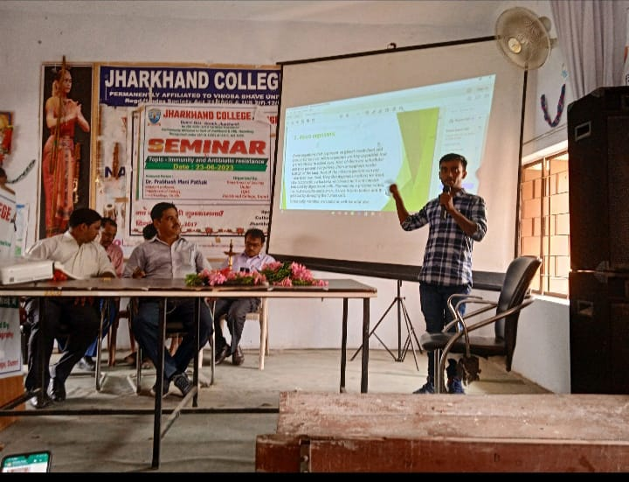
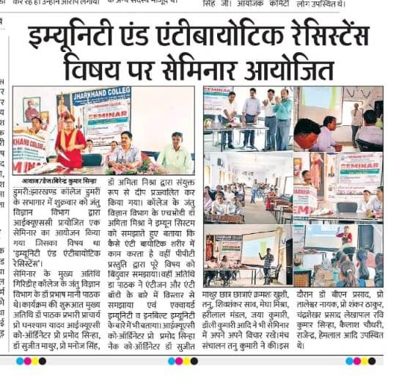
PHOTO AND PRESS RELEASE OF THE SEMINAR.

Slide 54
FIELD WORK ON THE BIODIVERSITY.
From dated 24.05.23 to 02.06.23, a National campaign on updating cum verification on People’s Biodiversity Registers (PBR), was conducted by the Department of Zoology, JCD.
The students visited the local Panchayat and collected the data of various animals and the plants species.

Slide 55
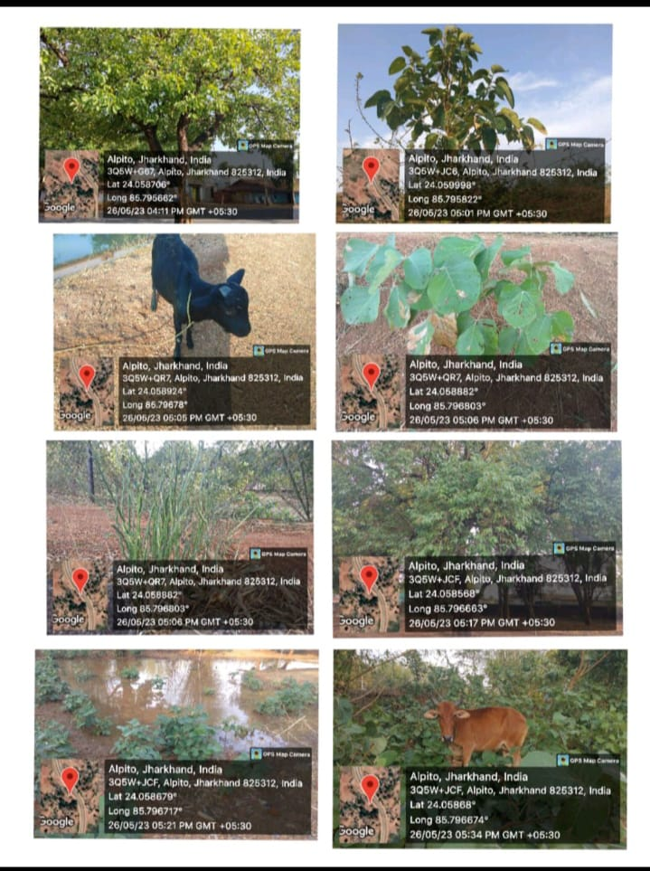
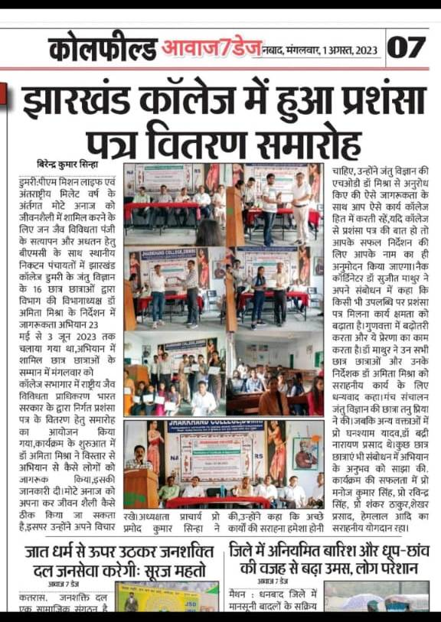
PHOTO AND PRESS RELEASE OF THE FIELD WORK, ON BIODIVERSITY.

Slide 56
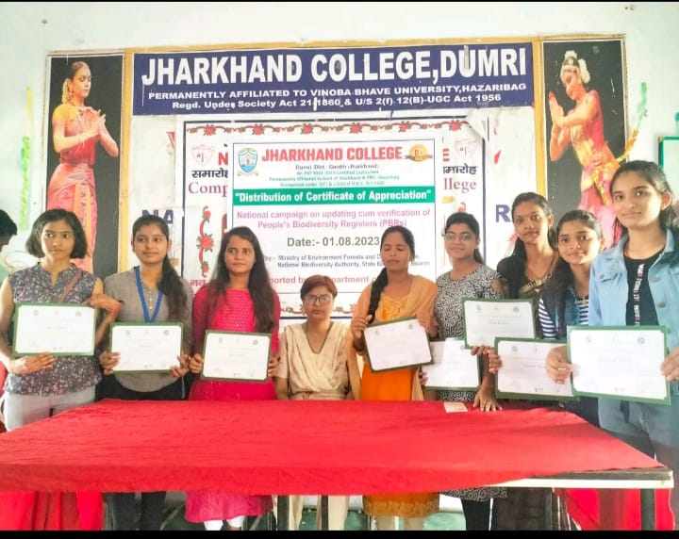
DISTRIBUTION OF CERTIFICATE OF APPRECIATION.DATED:-01.08.23

Slide 57
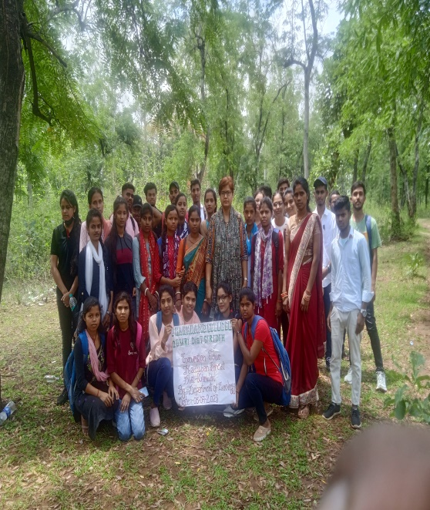
EXCURSION.TOUR.
PLACE:- MADHUBAN FOREST.
On dated 05.07.23, the students from the Department of Zoology visited the Madhuban Forest, and studied the ecosystem of the forest.

Slide 58
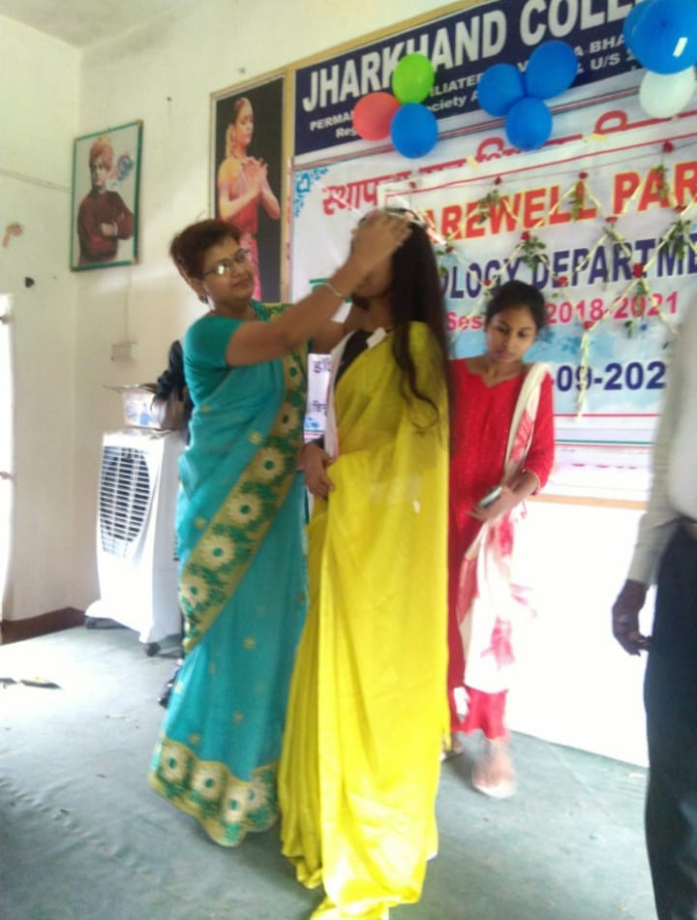
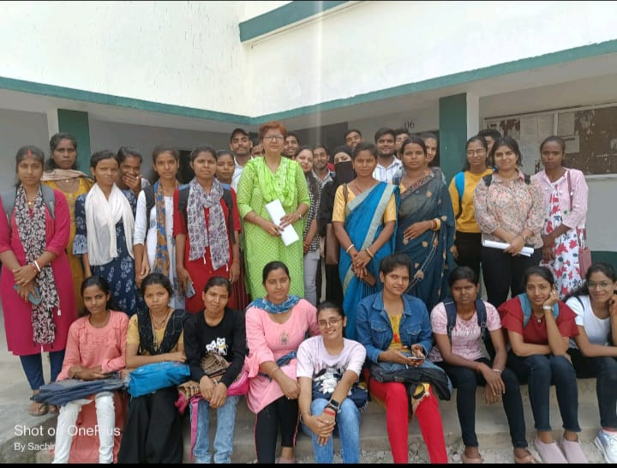
FAREWELL.

Slide 59
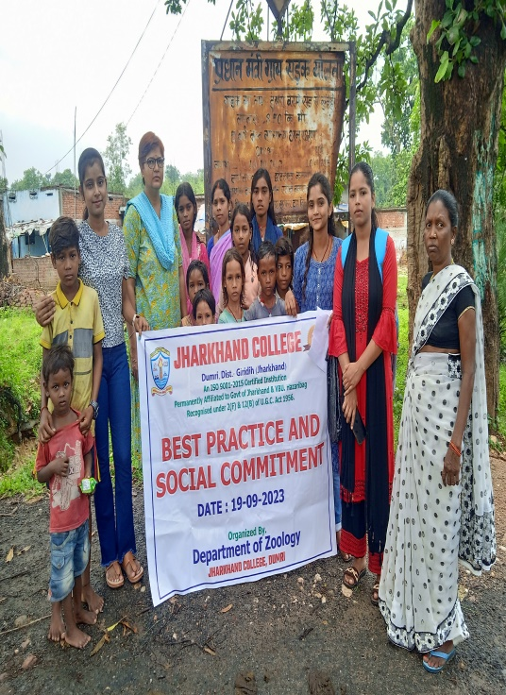
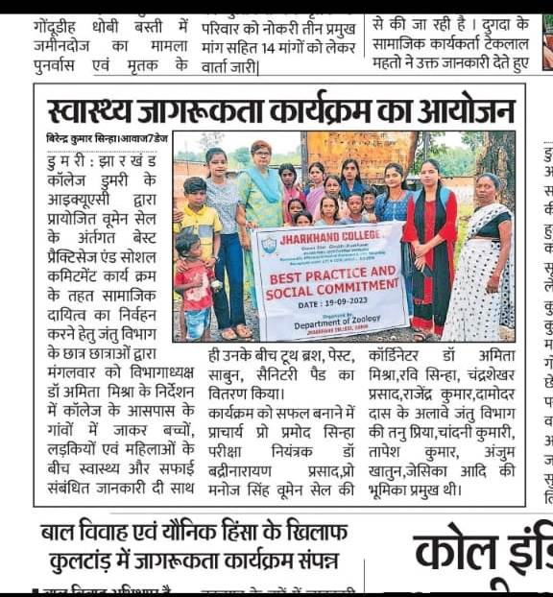
SOCIAL COMMITMENT OF THE DEPARTMENT OF ZOOLOGY, DATED:- 19.09.23

Slide 60
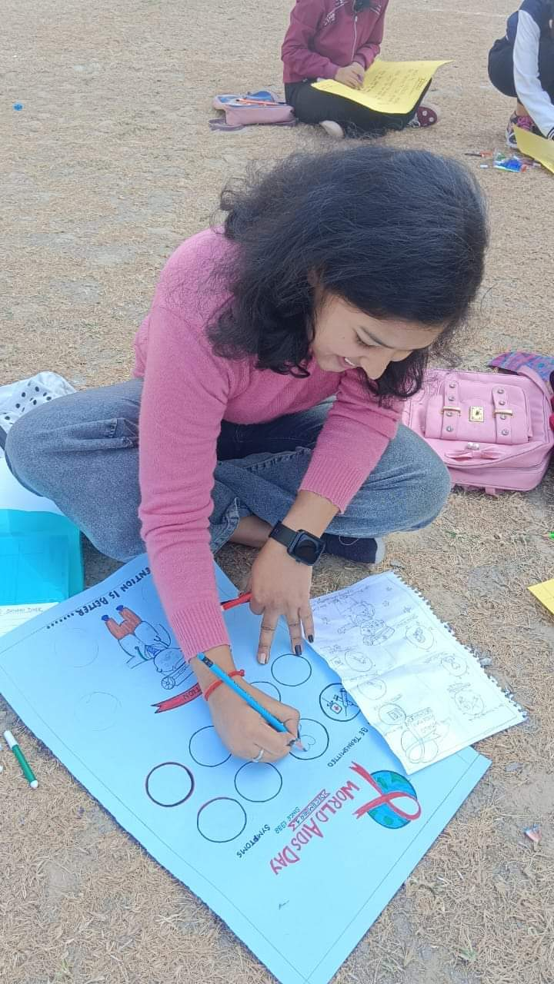
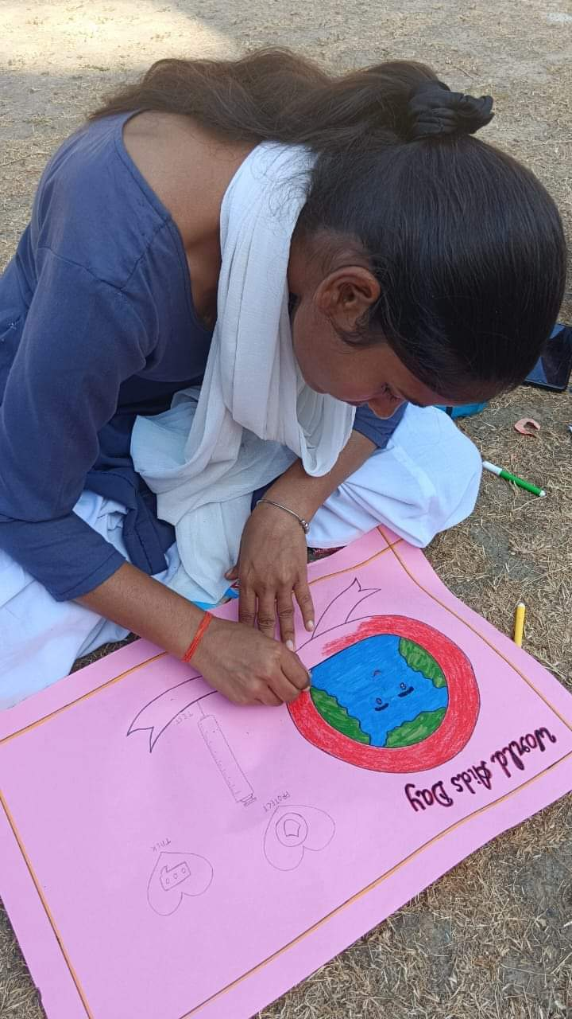
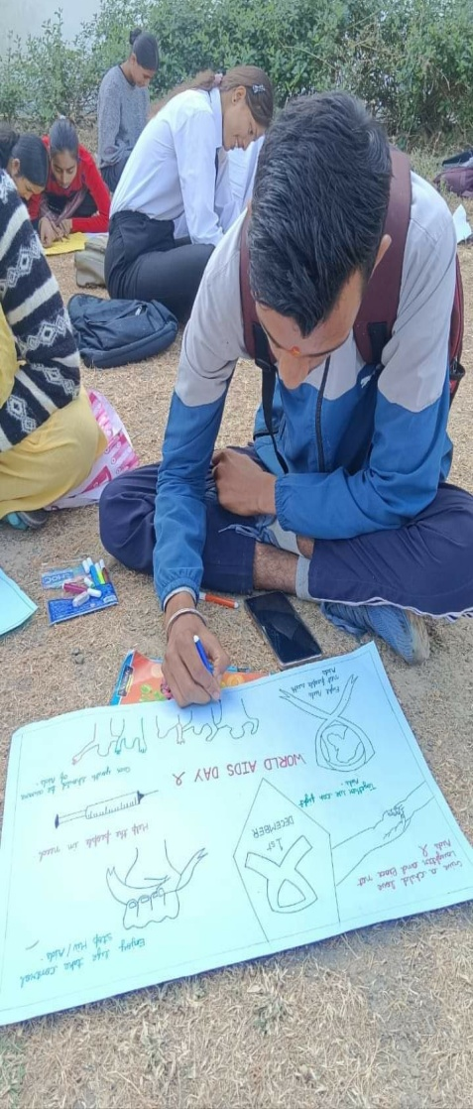
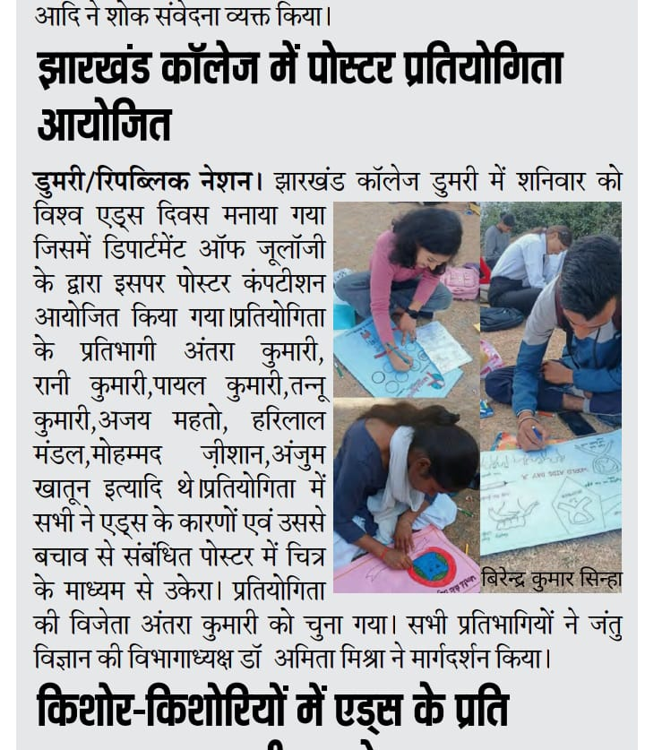
POSTER COMPETITION ON WORLD,S AIDS DAY, 01.12.23.

Slide 61
FIELD STUDY
TOPIC:- STUDY ON LACCULTURE IN THE GHUTWALI FOREST.
On dated 02.03.24, the students of semester 5, of the session 2021-2024, visited the Ghutwali Forest and studied about the lac insects on the host plant , Plum tree, Ziziphyus mauritiana, and prepared a project report on the same and presented in the Department of Zoology.
The Field study was conducted under the supervision of Dr. Amita Mishra, Head of the Department, Jharkhand College, Dumri.

Slide 62
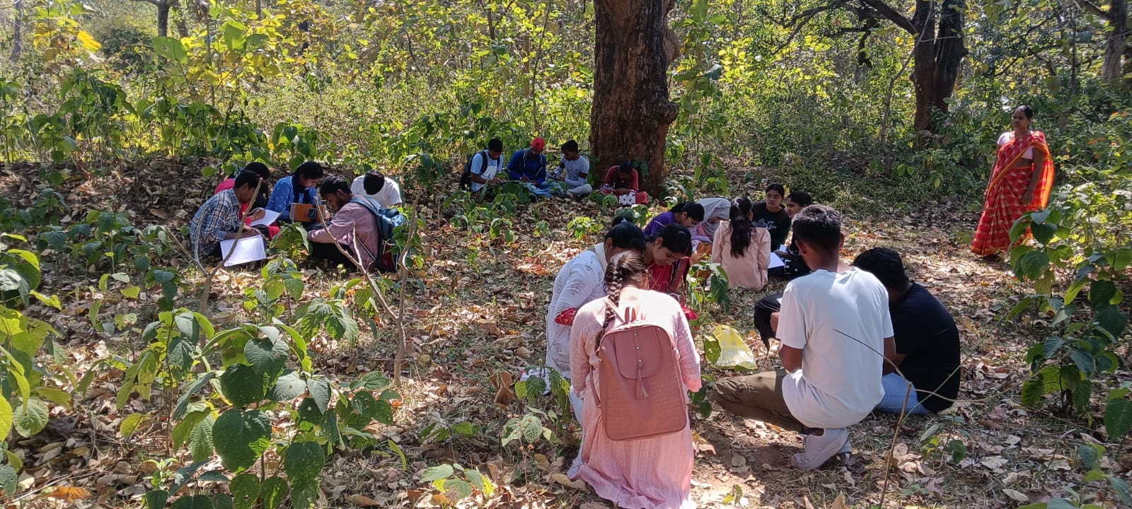
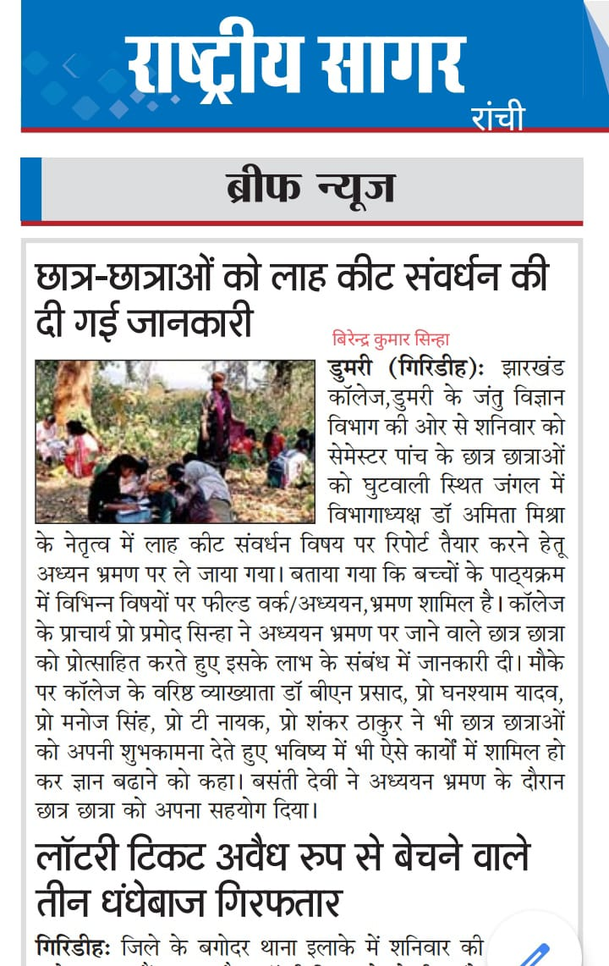
PHOTOS AND PRESS RELEASE OF THE FIELD STUDY

Slide 63
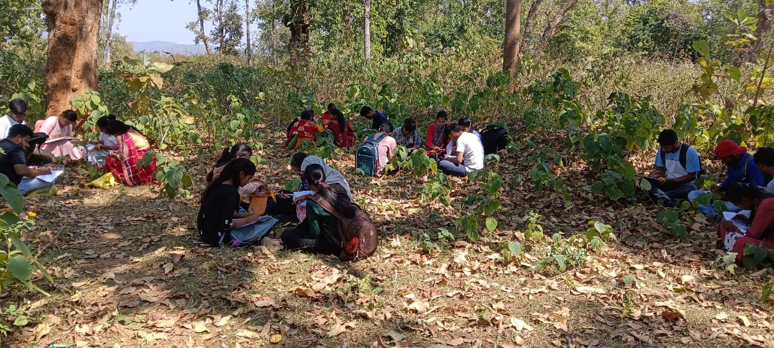
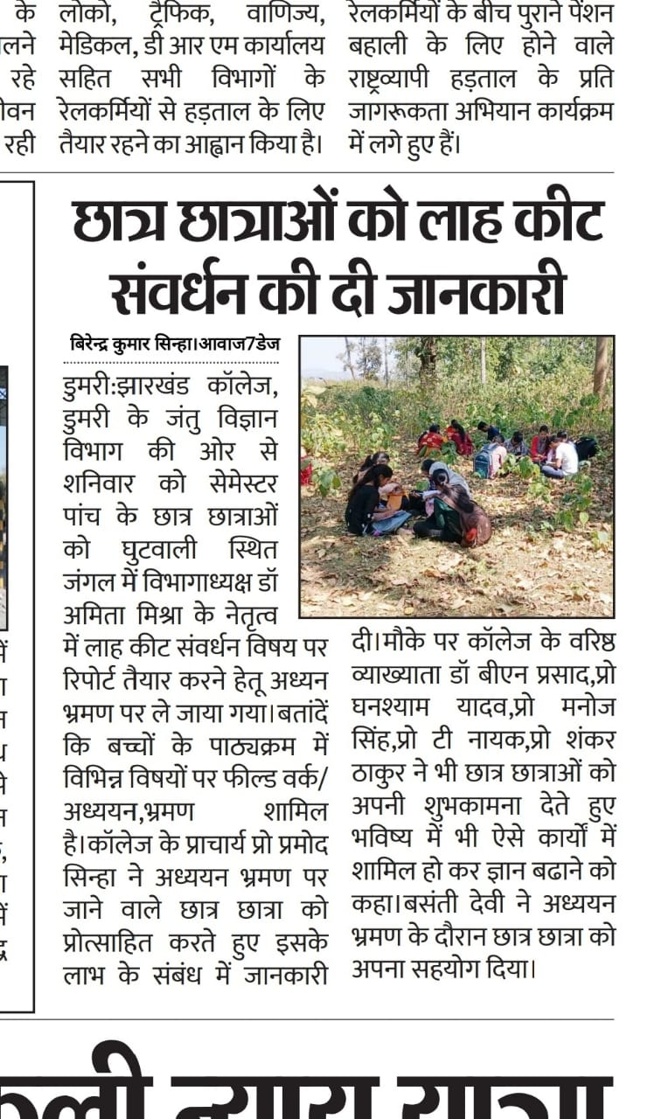
PHOTOS AND PRESS RELEASE OF THE FIELD STUDY

Slide 64
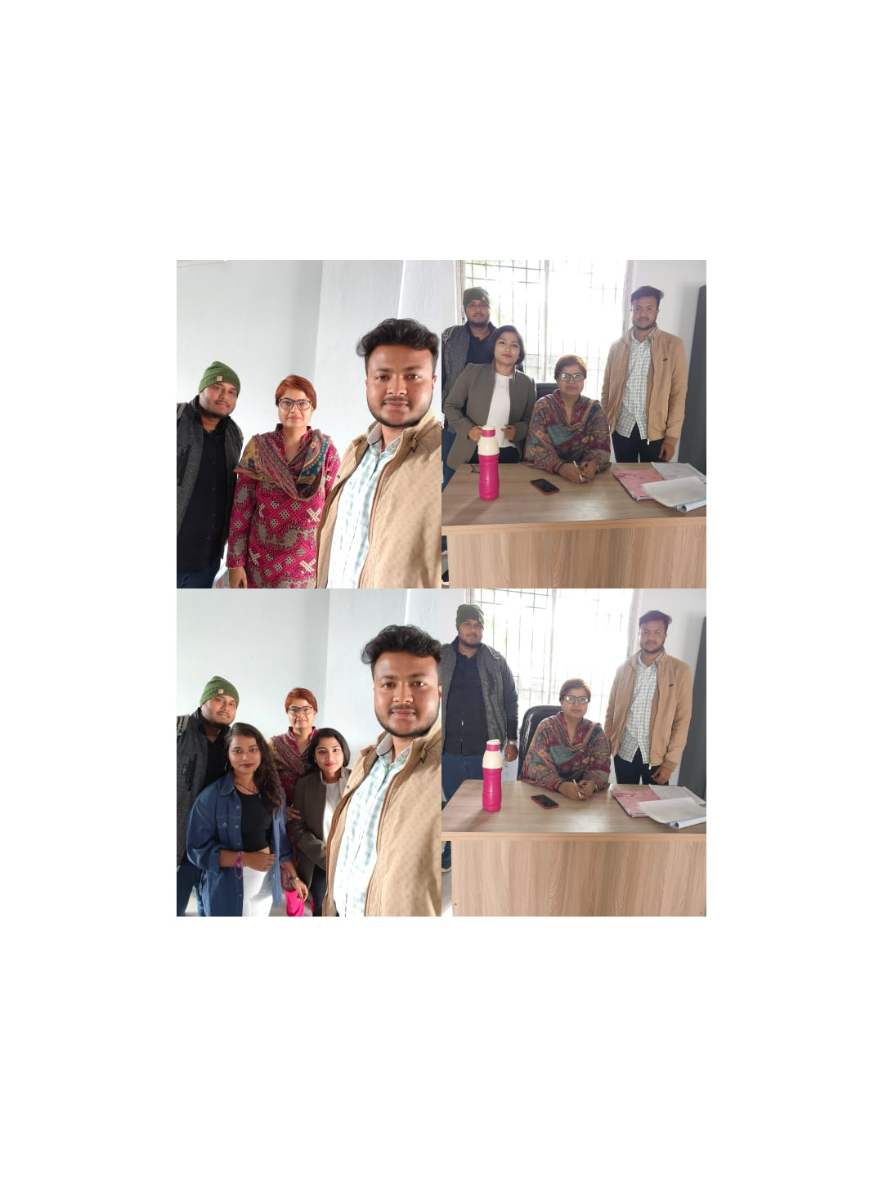
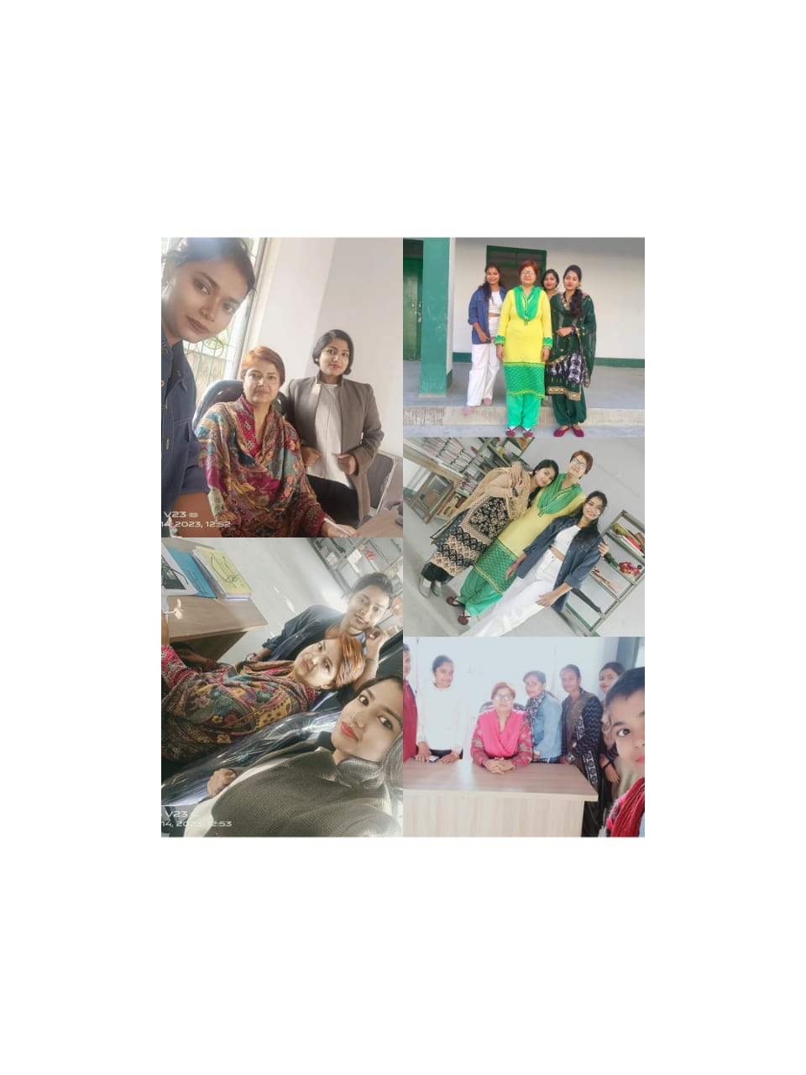
Glimpses of the teacher alumni association and interaction.

Slide 65
10. SWOC
STRENGTHS
The Department of Zoology has efficient Faculty to provide education with complete dedication and motivation.
Majority of the students of the Department of Zoology comes from the rural areas.
Laboratory work is done on regular basis to emphasize the theoretical concepts.

Slide 66
WEAKNESS
Most of the students are from Hindi medium, thus sometimes its harder for them to understand the concepts.
Educational trips need to be organised frequently to give exposure to the learners.
Opportunities:- students of the rural areas lying in the vicinity of the campus can be imparted education.
Challenges:- Development in the infrastructure.

